Slide 1
Elliptic Curve Cryptography
Dr.V.Ilayaraja_SCOPE_VIT

Slide 2
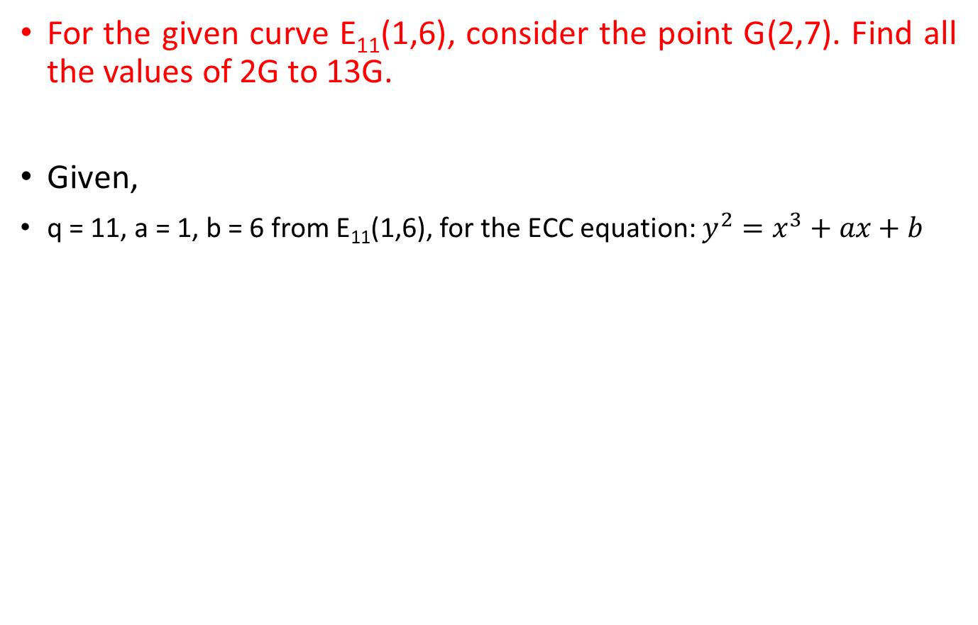
Problem:
Dr.V.Ilayaraja_SCOPE_VIT

Slide 3
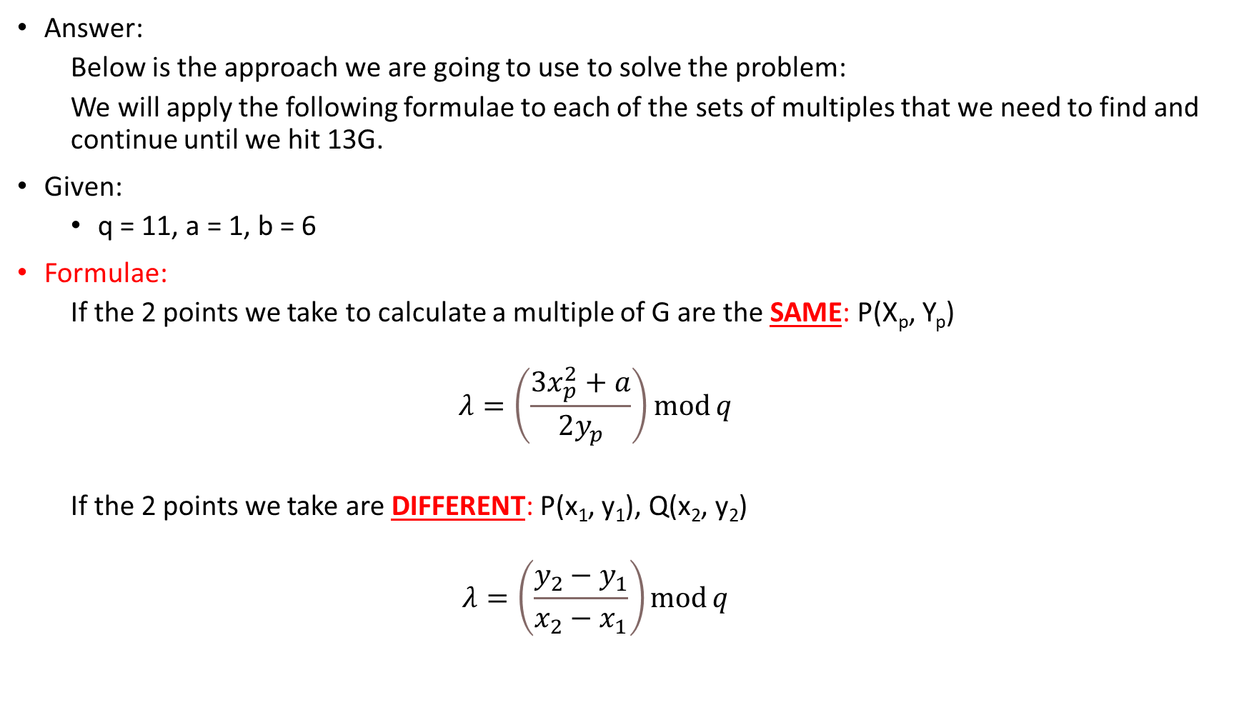
Dr.V.Ilayaraja_SCOPE_VIT

Slide 4
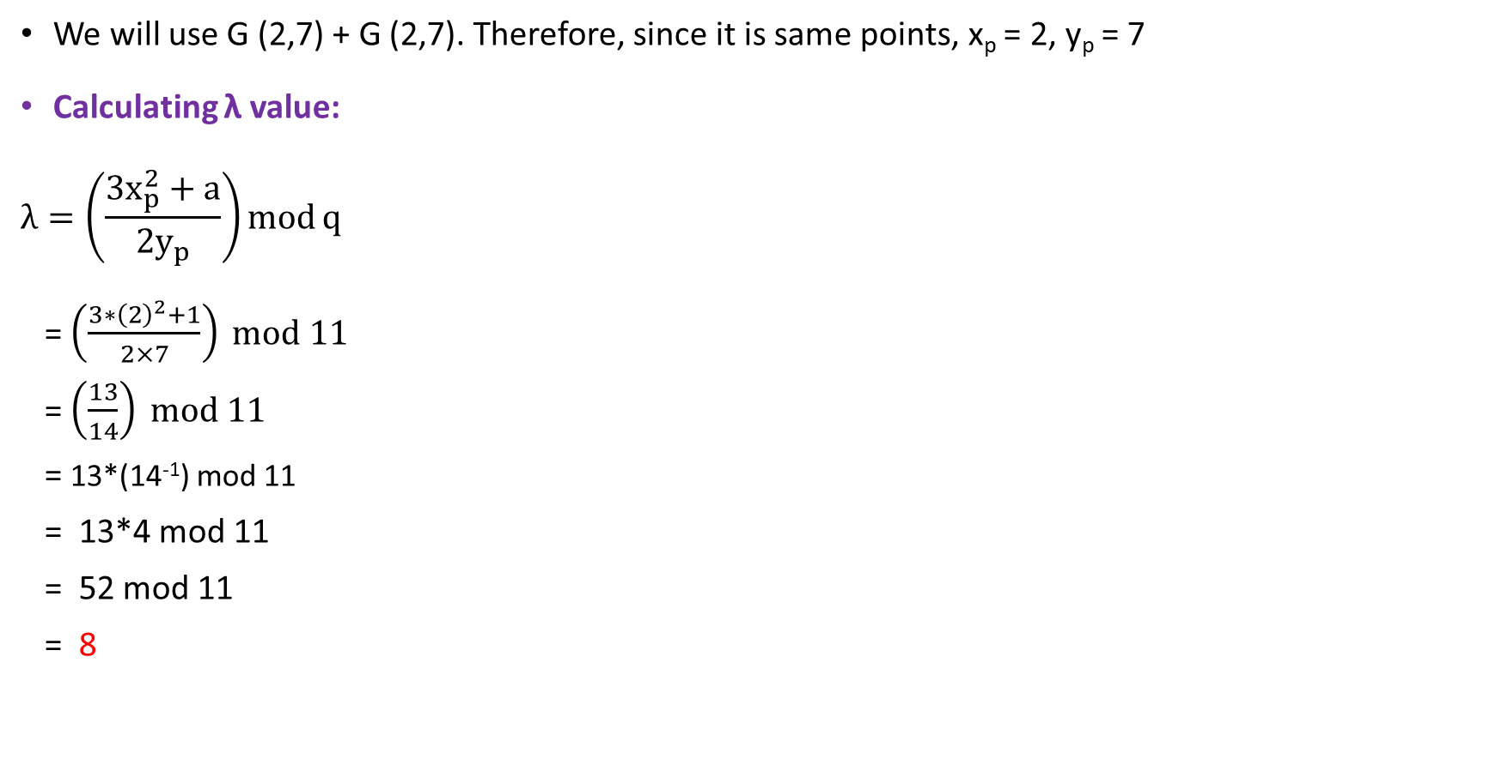
Calculate 2G value:
Calculating 14⁻¹ mod 11
14 x ? mod 11 = 1
Possible values are 1 to n-1, so, 1 – 10
After applying values 1,2,3 we can see that mod value doesn’t give 1.
So, the answer after applying 4:
14 x 4 mod 11 = 56 mod 11 = 1.
Answer is 4.
Dr.V.Ilayaraja_SCOPE_VIT

Slide 5
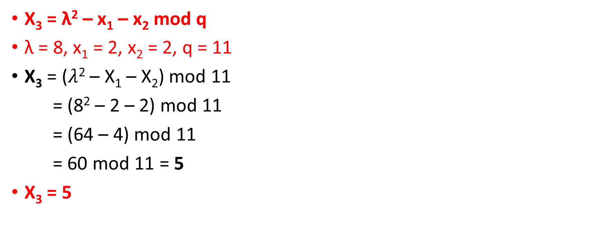
Calculate 2G value: X₃ value
Dr.V.Ilayaraja_SCOPE_VIT

Slide 6
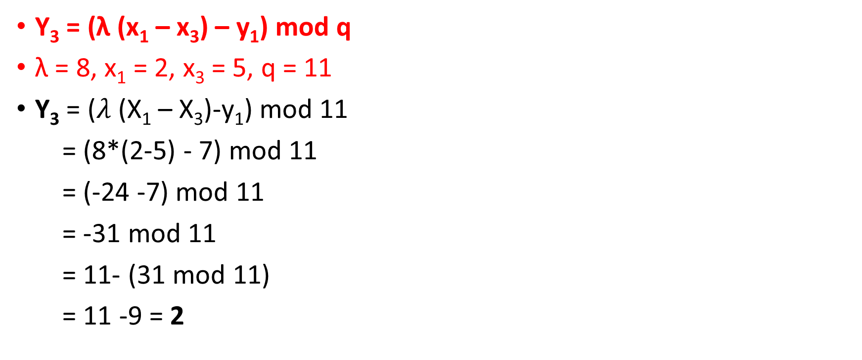
Calculate 2G value: Y₃ value
Thus, 2G is (5,2)
Dr.V.Ilayaraja_SCOPE_VIT

Slide 7
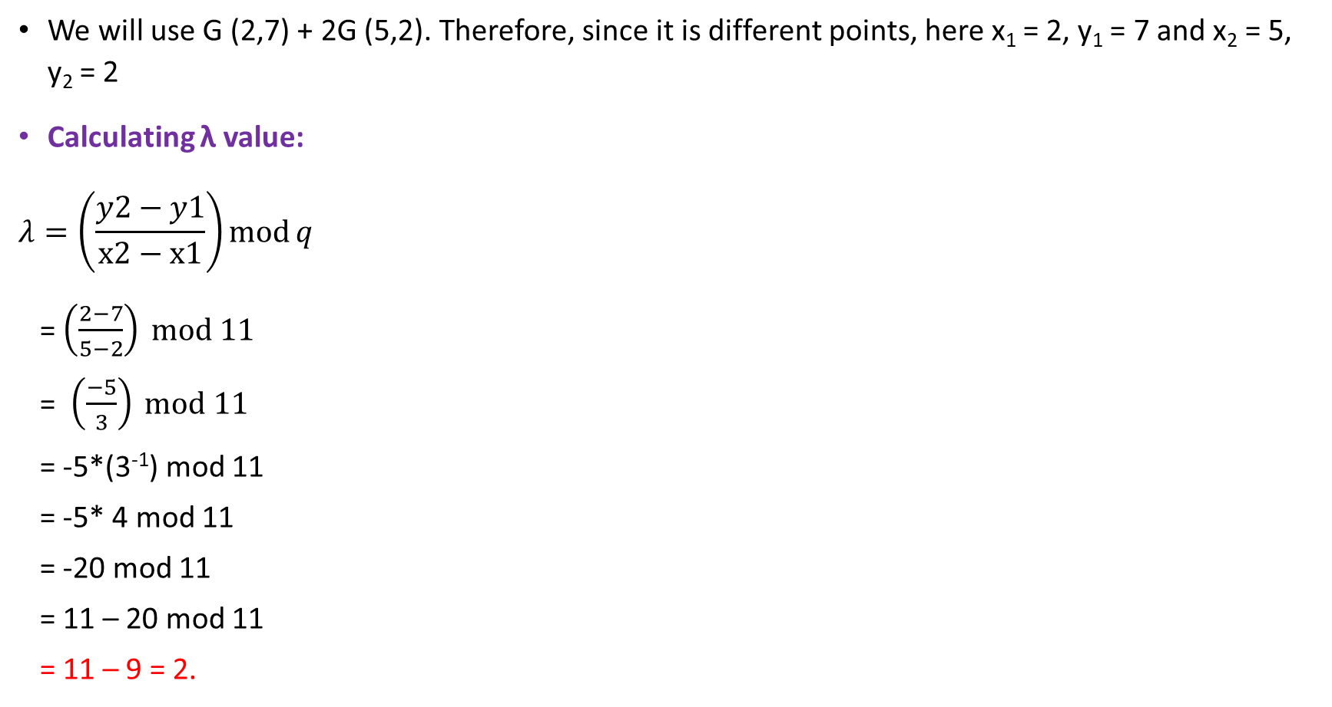
Calculate 3G value:
Calculating 3⁻¹ mod 11
3 x ? mod 11 = 1
Possible values are 1 to n-1, so, 1 – 10
3 x 1 mod 11 = 3 != 1
3 x 2 mod 11 = 6 != 1
3 x 3 mod 11 = 9 != 1
After applying values 1,2,3 we can see that mod value doesn’t give 1.
So, the answer after applying 4:
3 x 4 mod 11 = 12 mod 11 = 1.
Answer is 4.
Dr.V.Ilayaraja_SCOPE_VIT

Slide 8
Calculate 3G value: X₃ value
X₃ = λ² – x₁ – x₂ mod q
λ = 2, x₁ = 2, y₁ = 7, x₂ = 5, y₂ =2
X₃ = (2² – 2 – 5) mod 11
= (4 – 7) mod 11
= -3 mod 11
= 11 – 3 mod 11
= 11 - 3 = 8
X₃ = 8
Dr.V.Ilayaraja_SCOPE_VIT

Slide 9
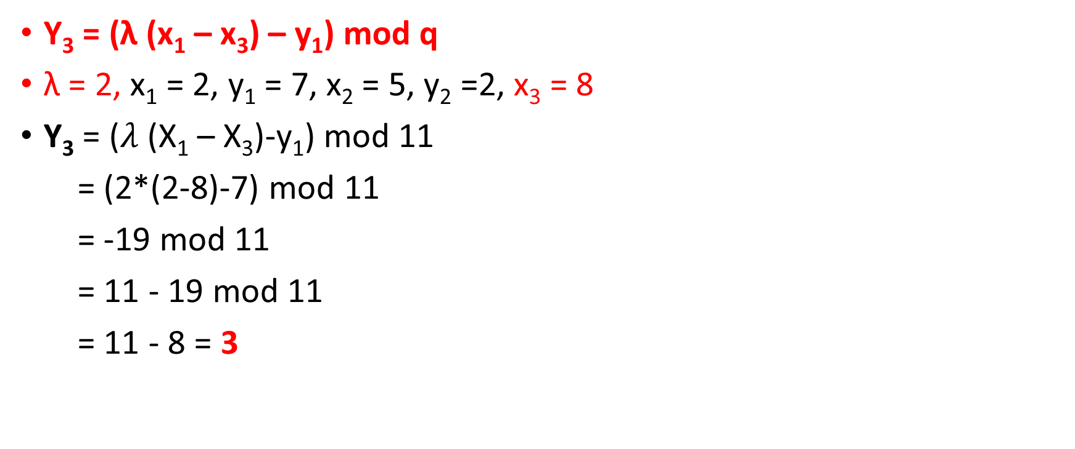
Calculate 3G value: Y₃ value
Thus, 3G is (8,3)
Dr.V.Ilayaraja_SCOPE_VIT

Slide 10
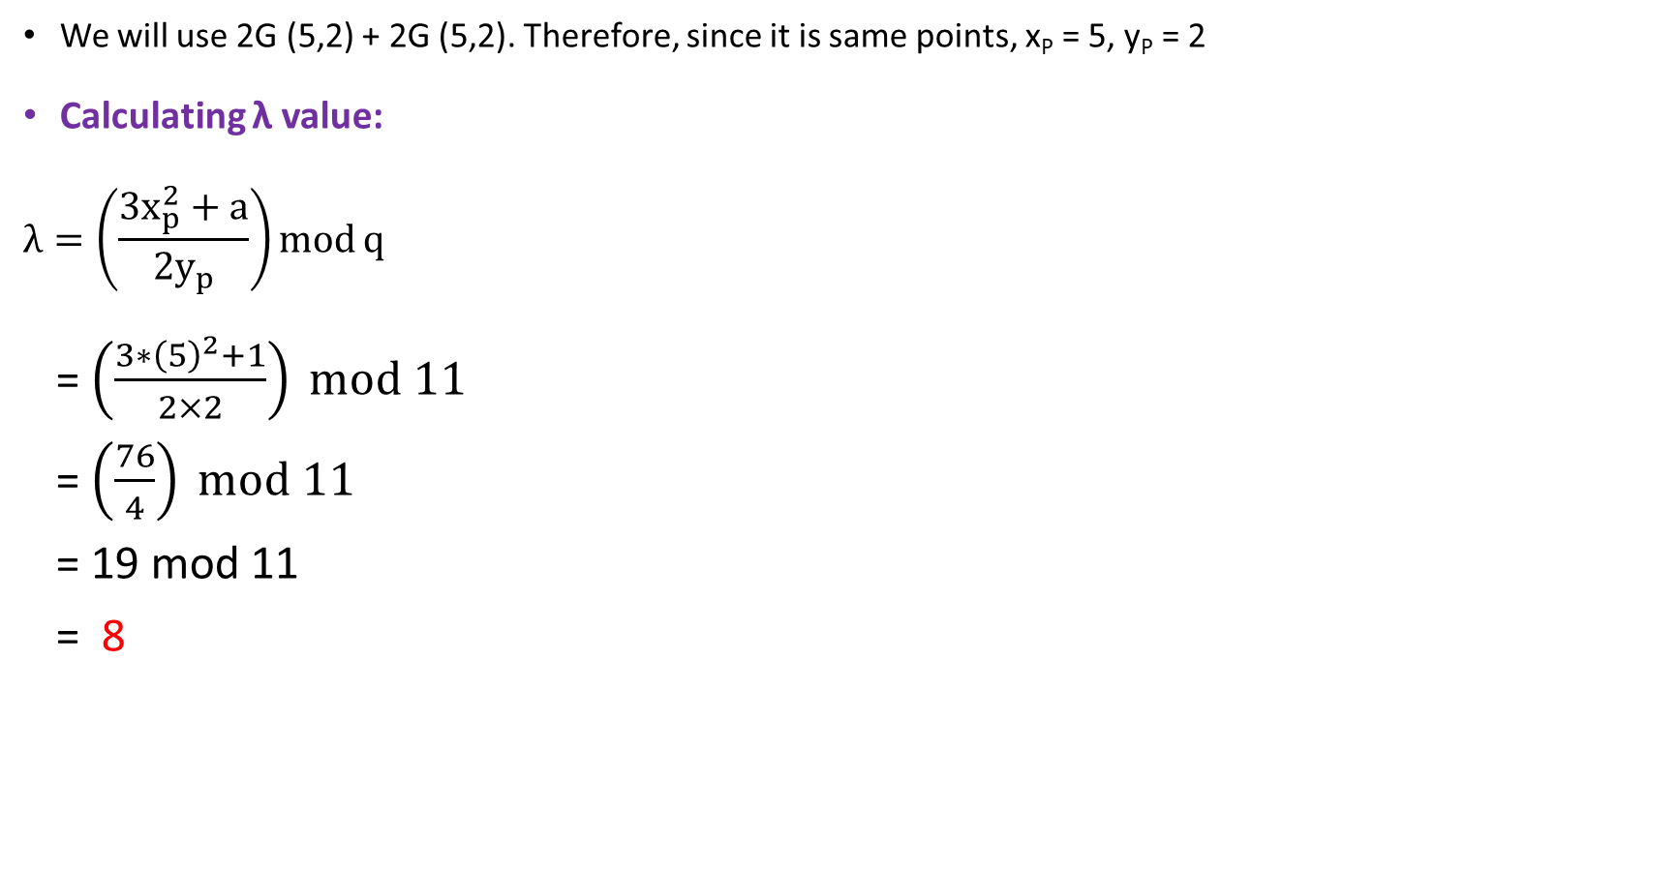
Calculate 4G value:
Dr.V.Ilayaraja_SCOPE_VIT

Slide 11
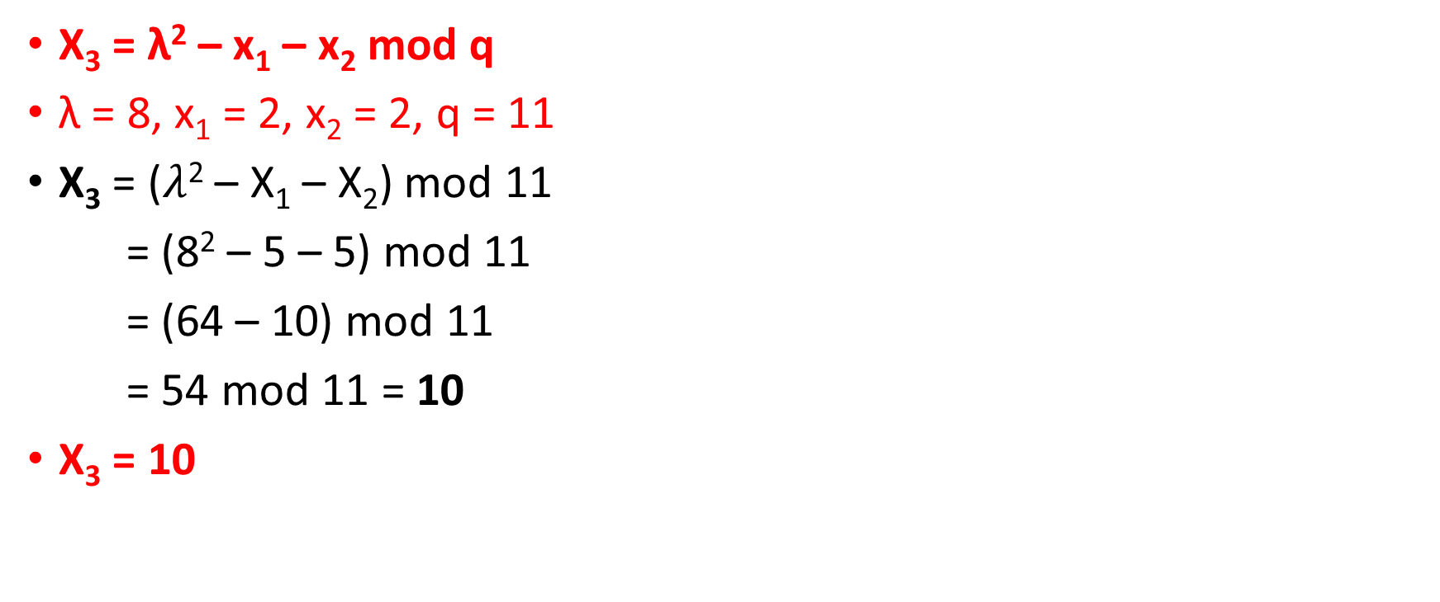
Calculate 4G value: X₃ value
Dr.V.Ilayaraja_SCOPE_VIT

Slide 12
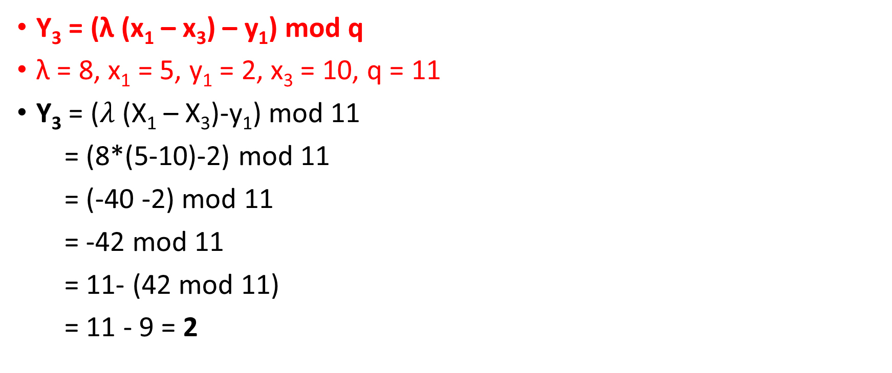
Calculate 4G value: Y₃ value
Thus, 4G is (10,2)
Dr.V.Ilayaraja_SCOPE_VIT

Slide 13
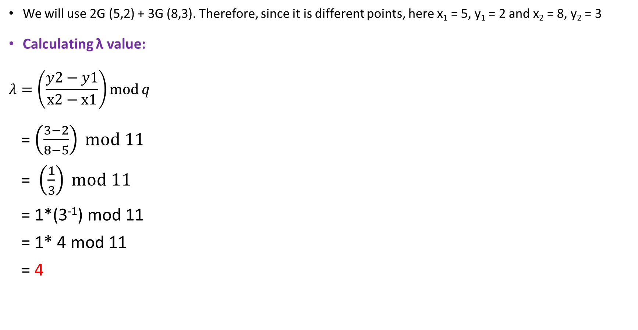
Calculate 5G value:
Calculating 3⁻¹ mod 11
3 x ? mod 11 = 1
Possible values are 1 to n-1, so, 1 – 10
After applying values 1,2,3 we can see that mod value doesn’t give 1.
So, the answer after applying 4:
3 x 4 mod 11 = 12 mod 11 = 1.
Answer is 4.
Dr.V.Ilayaraja_SCOPE_VIT

Slide 14
Calculate 5G value: X₃ value
X₃ = λ² – x₁ – x₂ mod q
λ = 4, x₁ = 5, y₁ = 2 and x₂ = 8, y₂ = 3
X₃ = (4² – 5 – 8) mod 11
= (16 – 13) mod 11
= 3 mod 11 = 3
X₃ = 3
Dr.V.Ilayaraja_SCOPE_VIT

Slide 15
Calculate 5G value: Y₃ value
Y₃ = (λ (x₁ – x₃) – y₁) mod q
λ = 4, x₁ = 5, y₁ = 2 and x₂ = 8, y₂ = 3, and x₃ = 3
Y₃ = (4*(5 - 3) - 2) mod 11
= (8 – 2) mod 11
= 6 mod 11 = 6
Thus, 5G is (3,6)
Dr.V.Ilayaraja_SCOPE_VIT

Slide 16
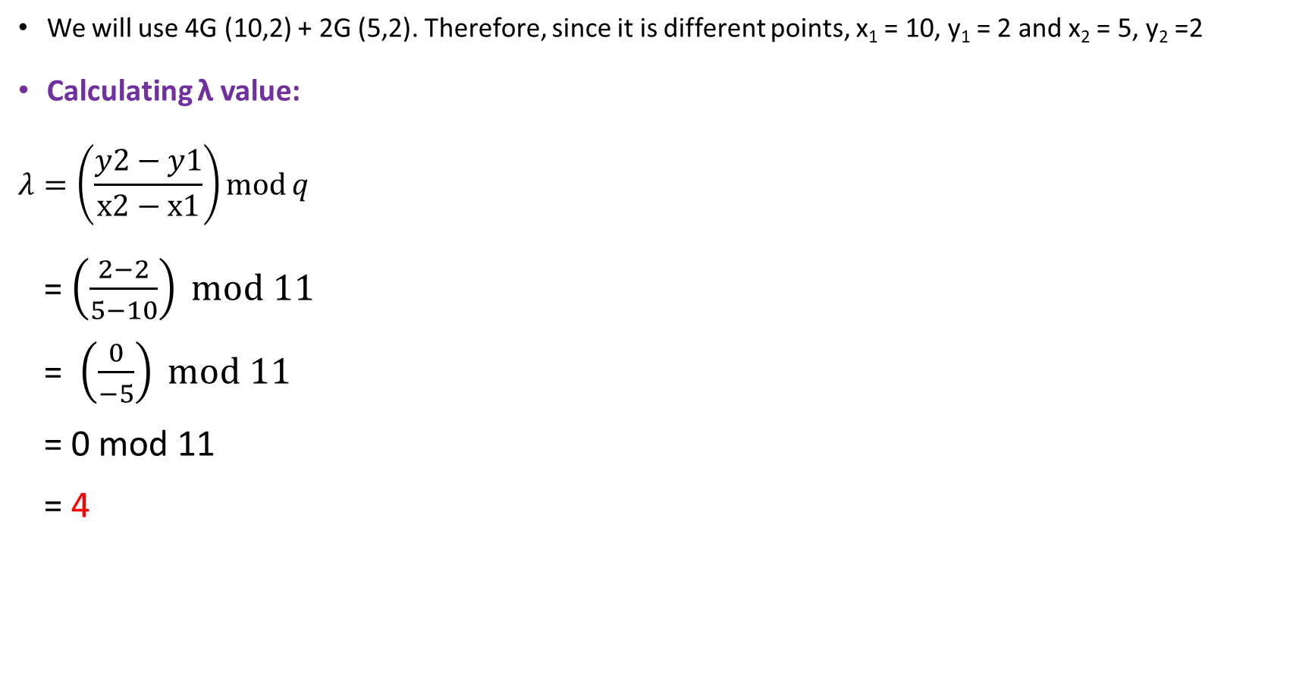
Calculate 6G value:
Dr.V.Ilayaraja_SCOPE_VIT

Slide 17
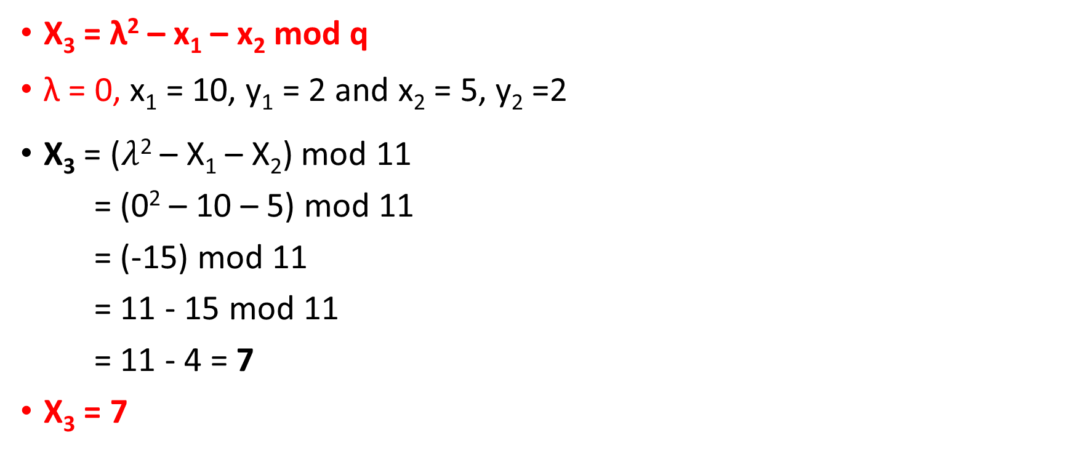
Calculate 6G value: X₃ value
Dr.V.Ilayaraja_SCOPE_VIT

Slide 18
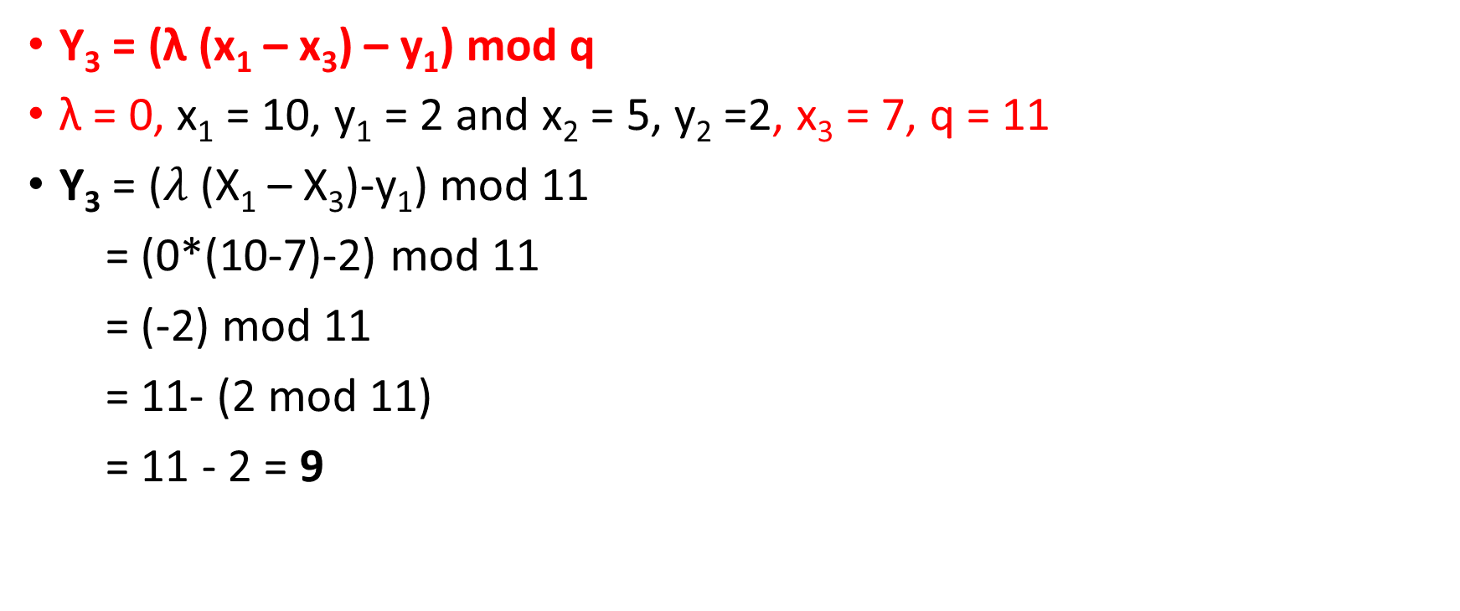
Calculate 6G value: Y₃ value
Thus, 6G is (7,9)
Dr.V.Ilayaraja_SCOPE_VIT

Slide 19

Calculate 7G value:
Calculating -2⁻¹ mod 11
-2 x ? mod 11 = 1
We can first convert -2 mod 11,
= 11 – 2 mod 11 = 9.
So, 9 x ? mod 11 = 1.
Possible values are 1 to n-1, so, 1 – 10
After applying values 1,2… 4 we can see that mod value doesn’t give 1.
So, the answer after applying 5:
9 x 5 mod 11 = 45 mod 11 = 1.
Answer is 5.
Dr.V.Ilayaraja_SCOPE_VIT

Slide 20
Calculate 7G value: X₃ value
X₃ = λ² – x₁ – x₂ mod q
λ = 9, x₁ = 5, y₁ = 2 and x₂ = 3, y₂ = 6
X₃ = (9² – 5 – 3) mod 11
= (81– 8) mod 11
= 73 mod 11 = 7
X₃ = 7
Dr.V.Ilayaraja_SCOPE_VIT

Slide 21
Calculate 7G value: Y₃ value
Y₃ = (λ (x₁ – x₃) – y₁) mod q
λ = 9, x₁ = 5, y₁ = 2 and x₂ = 3, y₂ = 6 and x₃ = 7
Y₃ = (9*(5 - 7) - 2) mod 11
= (-18 – 2) mod 11
= -20 mod 11
= 11 – 20 mod 11
= 11 – 9 = 2
Thus, 7G is (7,2)
Dr.V.Ilayaraja_SCOPE_VIT

Slide 22

Calculate 8G value:
Calculating 4⁻¹ mod 11
4 x ? mod 11 = 1
Possible values are 1 to n-1, so, 1 – 10
After applying values 1,2 we can see that mod value doesn’t give 1.
So, the answer after applying 4:
4 x 3 mod 11 = 12 mod 11 = 1.
Answer is 3.
Dr.V.Ilayaraja_SCOPE_VIT

Slide 23
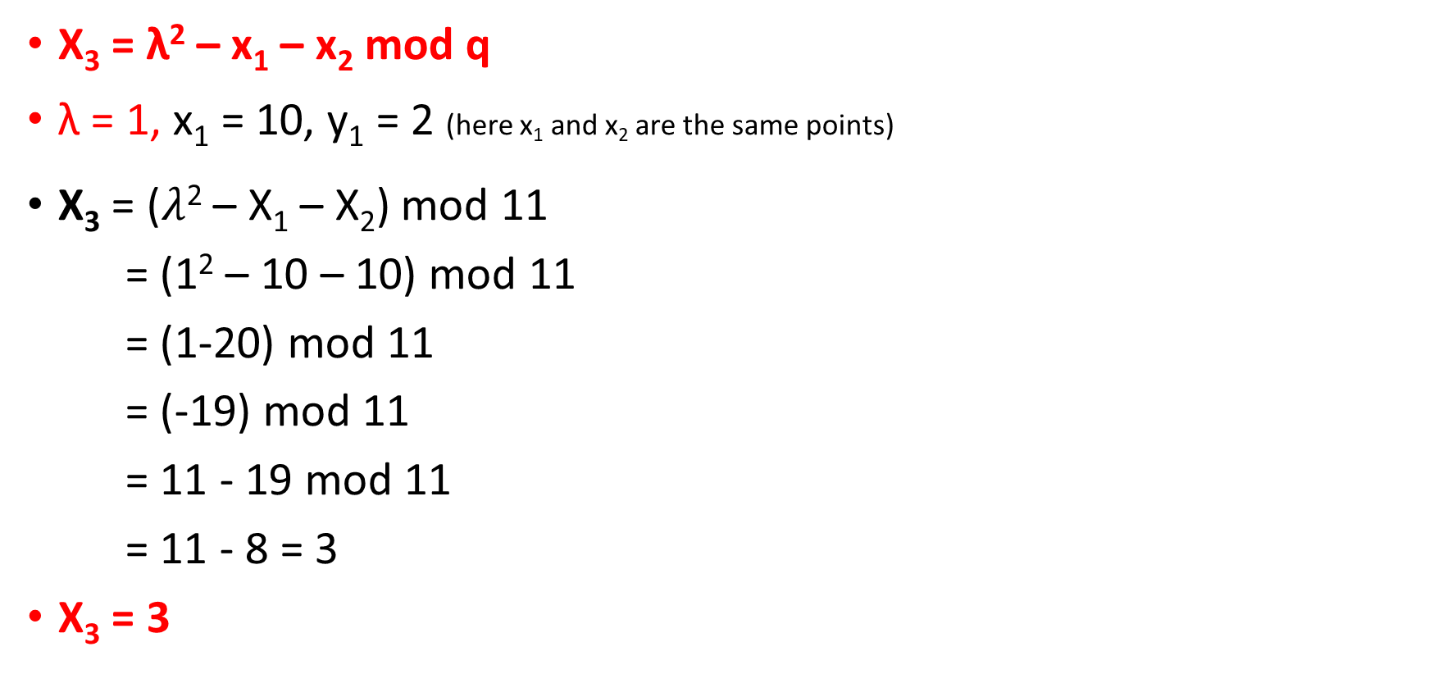
Calculate 8G value: X₃ value
Dr.V.Ilayaraja_SCOPE_VIT

Slide 24
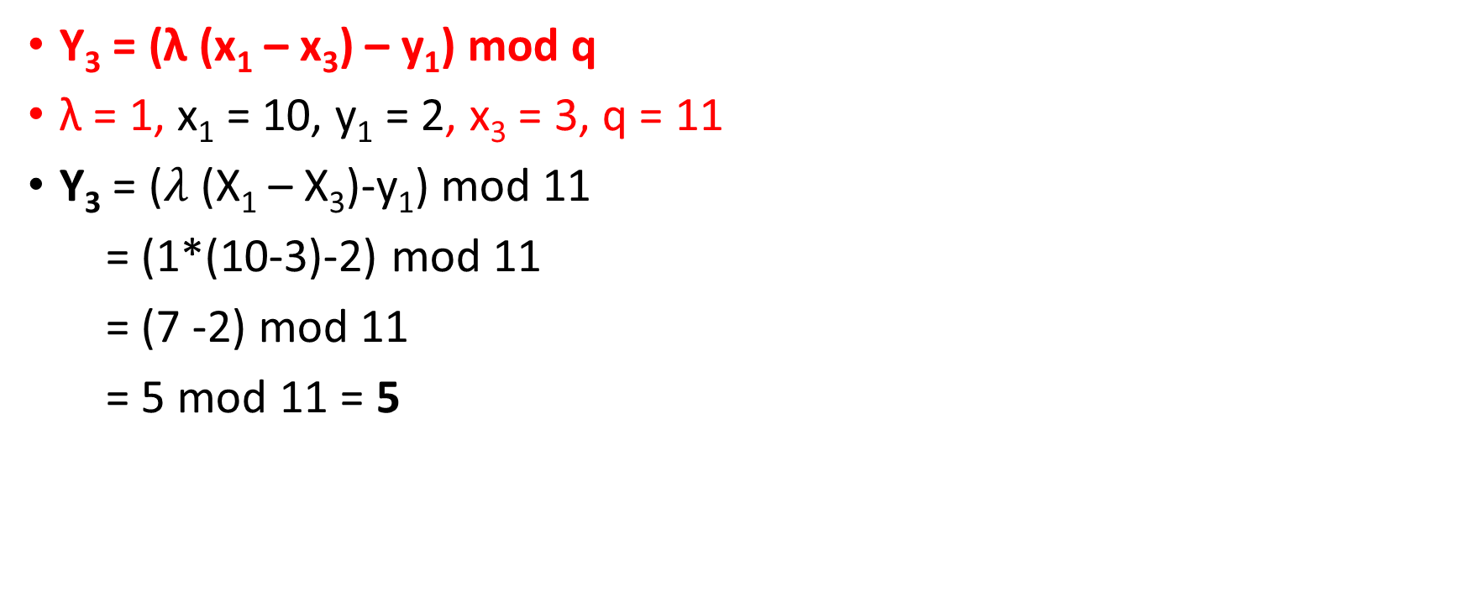
Calculate 8G value: Y₃ value
Thus, 8G is (3,5)
Dr.V.Ilayaraja_SCOPE_VIT

Slide 25
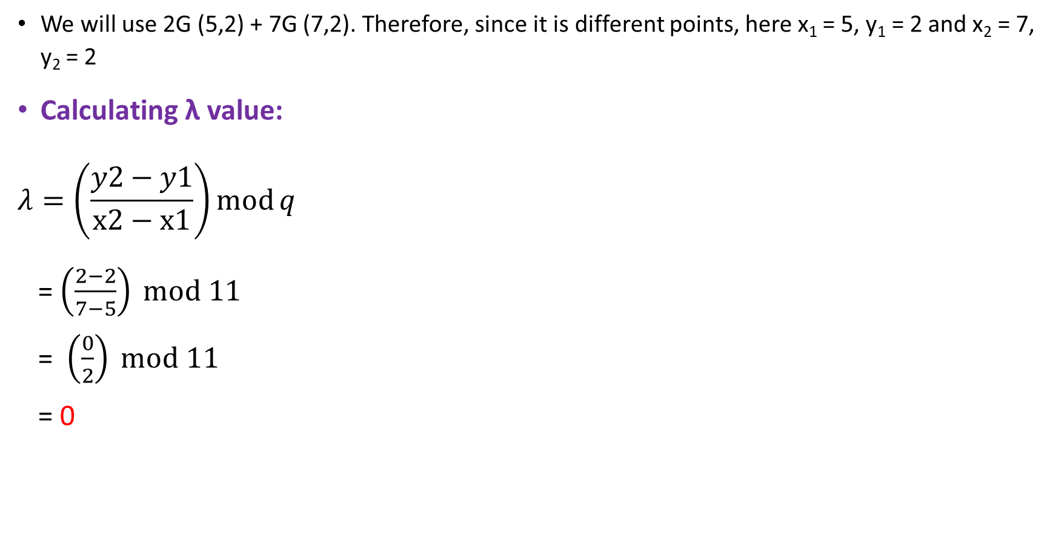
Calculate 9G value:
Dr.V.Ilayaraja_SCOPE_VIT

Slide 26
Calculate 9G value: X₃ value
X₃ = λ² – x₁ – x₂ mod q
λ = 0, x₁ = 5, y₁ = 2 and x₂ = 7, y₂ = 2
X₃ = (0² – 5 – 7) mod 11
= (-12) mod 11
= 11 - 12 mod 11
= 11 – 1 = 10
X₃ = 10
Dr.V.Ilayaraja_SCOPE_VIT

Slide 27
Calculate 9G value: Y₃ value
Y₃ = (λ (x₁ – x₃) – y₁) mod q
λ = 0, x₁ = 5, y₁ = 2 and x₂ = 7, y₂ = 2 and x₃ = 10
Y₃ = (0*(5 - 10) - 2) mod 11
= (– 2) mod 11
= 11 – 2 mod 11
= 11 – 2 = 9
Thus, 9G is (10,9)
Dr.V.Ilayaraja_SCOPE_VIT

Slide 28
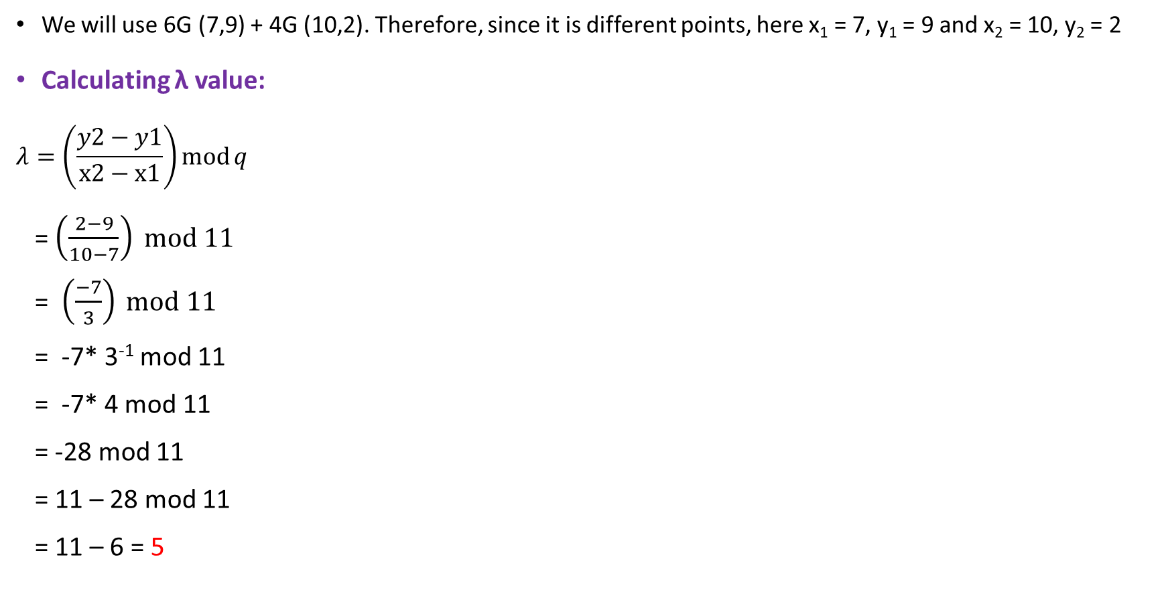
Calculate 10G value:
Calculating 3⁻¹ mod 11
3 x ? mod 11 = 1
Possible values are 1 to n-1, so, 1 – 10
After applying values 1,2,3 we can see that mod value doesn’t give 1.
So, the answer after applying 4:
3 x 4 mod 11 = 12 mod 11 = 1.
Answer is 4.
Dr.V.Ilayaraja_SCOPE_VIT

Slide 29

Calculate 10G value: X₃ value
Dr.V.Ilayaraja_SCOPE_VIT

Slide 30
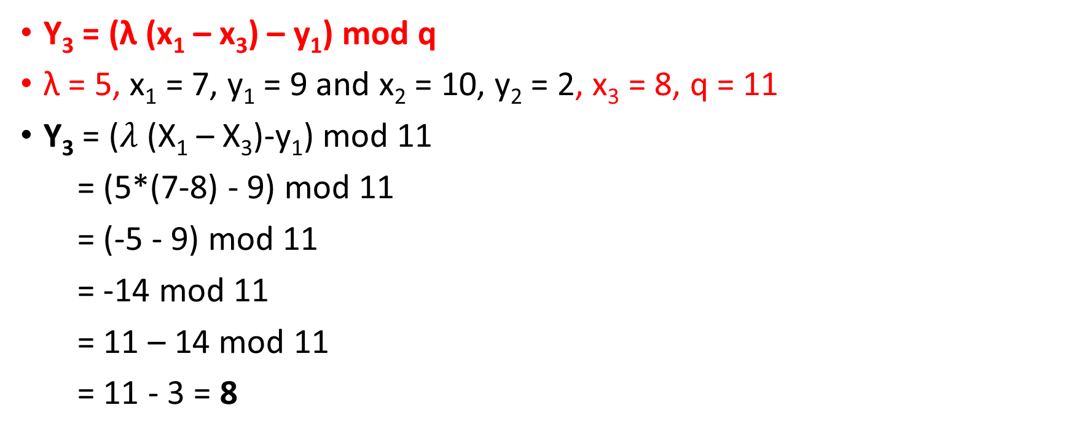
Calculate 10G value: Y₃ value
Thus, 10G is (8,8)
Dr.V.Ilayaraja_SCOPE_VIT

Slide 31

Calculate 11G value:
Calculating 5⁻¹ mod 11
5 x ? mod 11 = 1
Possible values are 1 to n-1, so, 1 – 10
After applying values 1,2… 8 we can see that mod value doesn’t give 1.
So, the answer after applying 9:
5 x 9 mod 11 = 45 mod 11 = 1.
Answer is 9.
Dr.V.Ilayaraja_SCOPE_VIT

Slide 32
Calculate 11G value: X₃ value
X₃ = λ² – x₁ – x₂ mod q
λ = 8, x₁ = 5, y₁ = 2 and x₂ = 10, y₂ = 9
X₃ = (8² – 5 – 10) mod 11
= (64 – 15) mod 11
= 49 mod 11 = 5
X₃ = 5
Dr.V.Ilayaraja_SCOPE_VIT

Slide 33
Calculate 11G value: Y₃ value
Y₃ = (λ (x₁ – x₃) – y₁) mod q
λ = 8, x₁ = 5, y₁ = 2 and x₂ = 10, y₂ = 9 and x₃ = 5
Y₃ = (8*(5 - 5) - 2) mod 11
= (0 – 2) mod 11
= 11 – 2 mod 11
= 11 – 2 = 9
Thus, 11G is (5,9)
Dr.V.Ilayaraja_SCOPE_VIT

Slide 34

Calculate 12G value:
Calculating 9⁻¹ mod 11
9 x ? mod 11 = 1
Possible values are 1 to n-1, so, 1 – 10
After applying values 1,2… 4 we can see that mod value doesn’t give 1.
So, the answer after applying 5:
9 x 5 mod 11 = 45 mod 11 = 1.
Answer is 5.
Dr.V.Ilayaraja_SCOPE_VIT

Slide 35
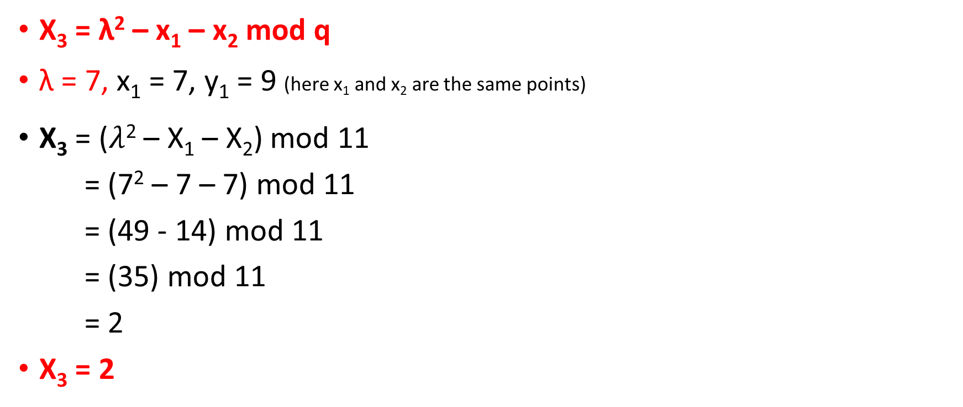
Calculate 12G value: X₃ value
Dr.V.Ilayaraja_SCOPE_VIT

Slide 36
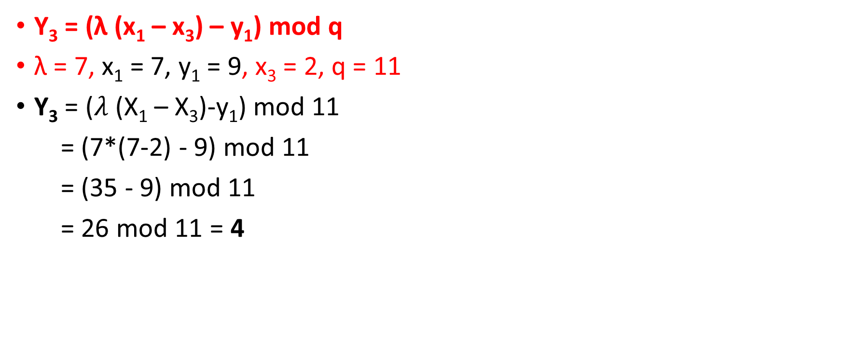
Calculate 12G value: Y₃ value
Thus, 12G is (2,4)
Dr.V.Ilayaraja_SCOPE_VIT

Slide 37
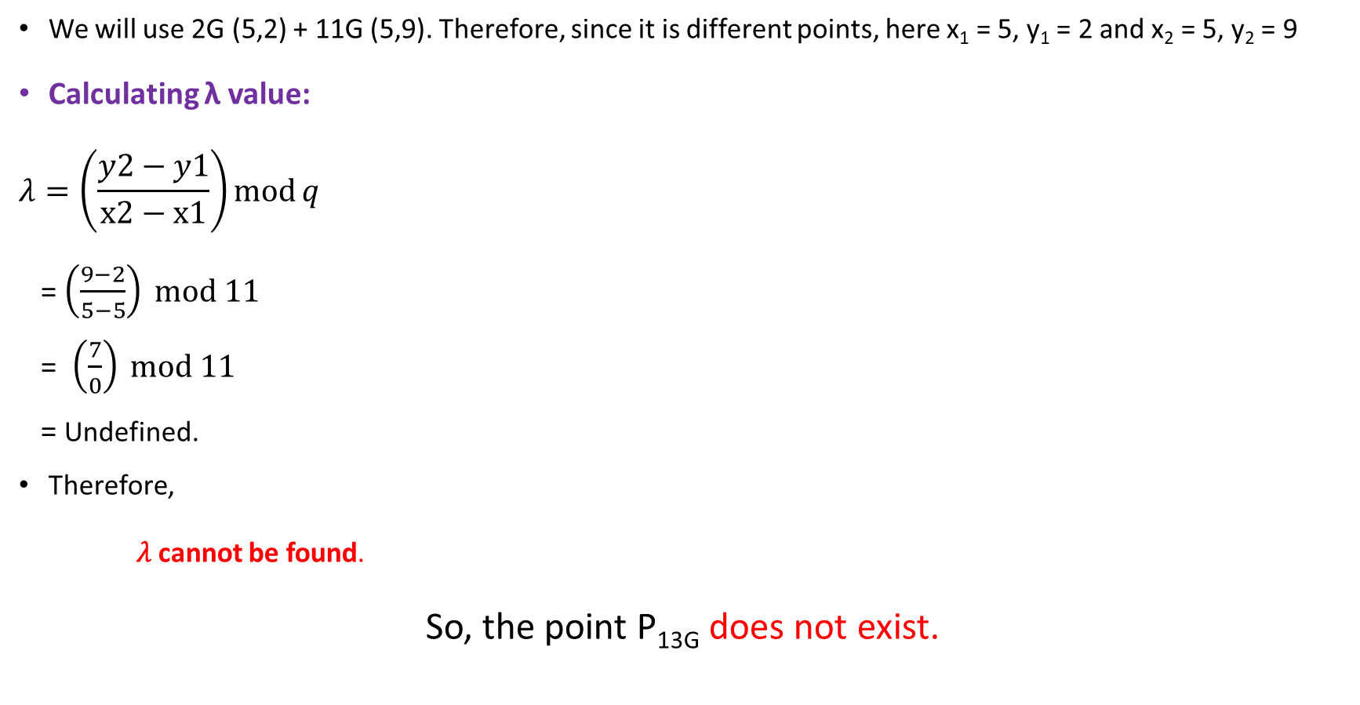
Calculate 13G value:
Dr.V.Ilayaraja_SCOPE_VIT

Slide 38
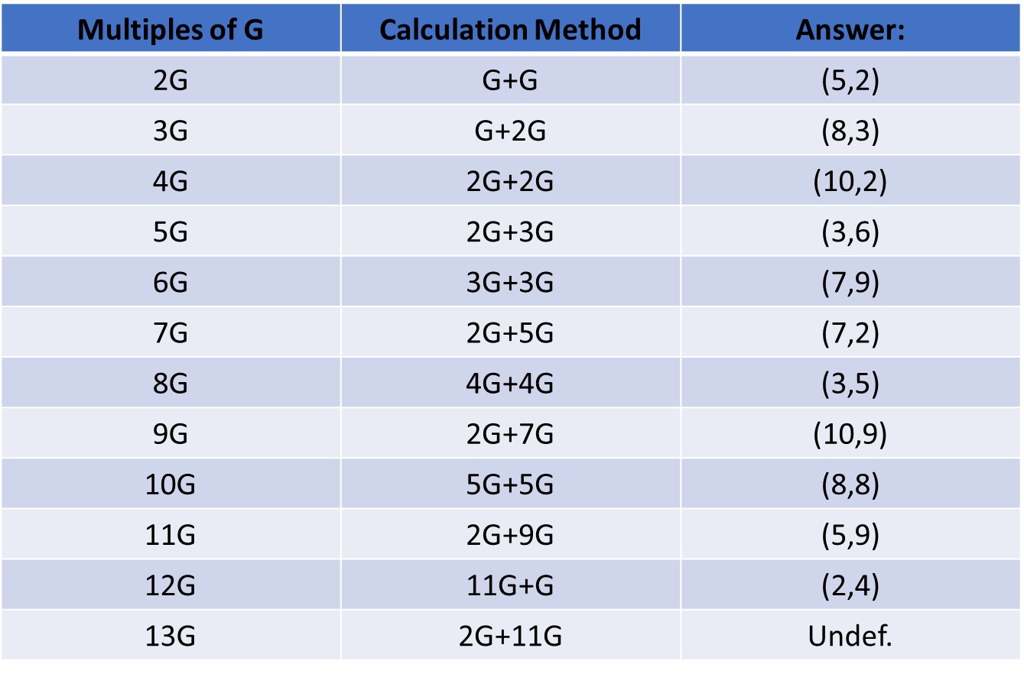
Final Solution: (Use for reference once completed).
Dr.V.Ilayaraja_SCOPE_VIT

